Slide 1
Capstone Project Week 2
Applied Data Science Capstone by IBM/Coursera
Bryan Garrido

Slide 2
Finding a location to build a new Chick-Fil-A in Austin
The average Chick-Fil-A restaurant grossed $4.4 million in 2016. This is $1.7 million more than any other fast food chain in the country
Chick-Fil-A hand picks people to operate its franchises and retains ownership of restaurant.
I met someone who was picked to operate a restaurant and is currently going through the training
The objective of this project is to identify areas in Austin, TX to open a new Chick-Fil-A restaurant

Slide 3
Data Sources and Cleaning
The City of Austin website has inspection data for every venue that serves food in the city. It can be found here. Inspection data dates back to December 2017.
There is a record for each inspection performed since 2017. Using Excel, I deleted any duplicate rows based on ‘Restaurant Name’ and ‘Address’. This resulted in a total of 5107 venues.
Latitude and longitude of each location is in the address feature. Less than 10% of the records were missing latitude and longitude. Used the geopy package to find the remaining GPS coordinates.

Slide 4
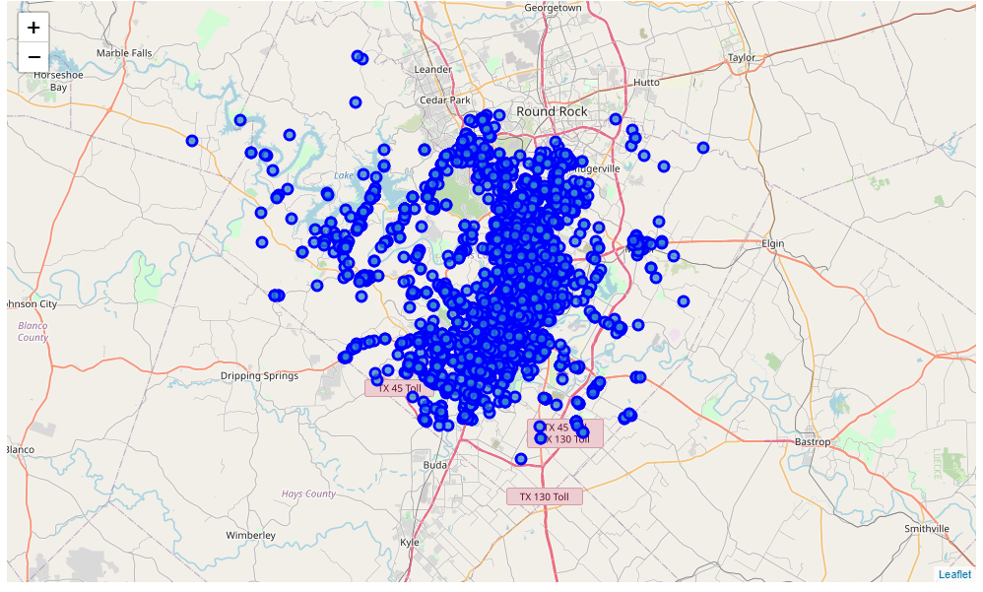
Austin Map of Restaurants
This map is too busy to even begin understanding where to look.
A python function was used to calculate the distance to nearest Chick-Fil-A using the GPS coordinates provided by the data set.
Removed locations that are within 3 miles of a Chick-Fil-A to find a focus area.

Slide 5
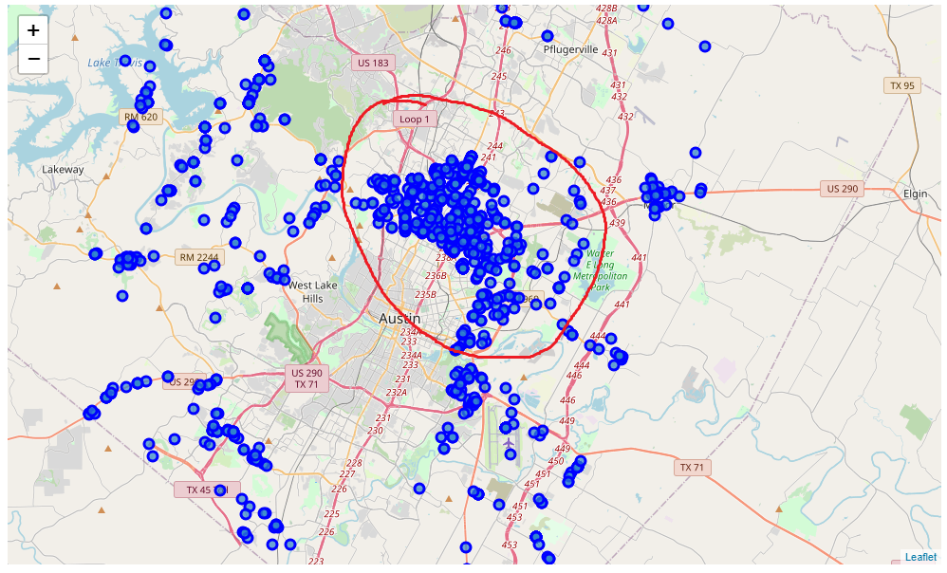
Area of Focus
There are 622 venues congregated in the North-Northwest area of Austin that are more than 3 miles from a Chick-Fil-A.
This will the focus area.

Slide 6
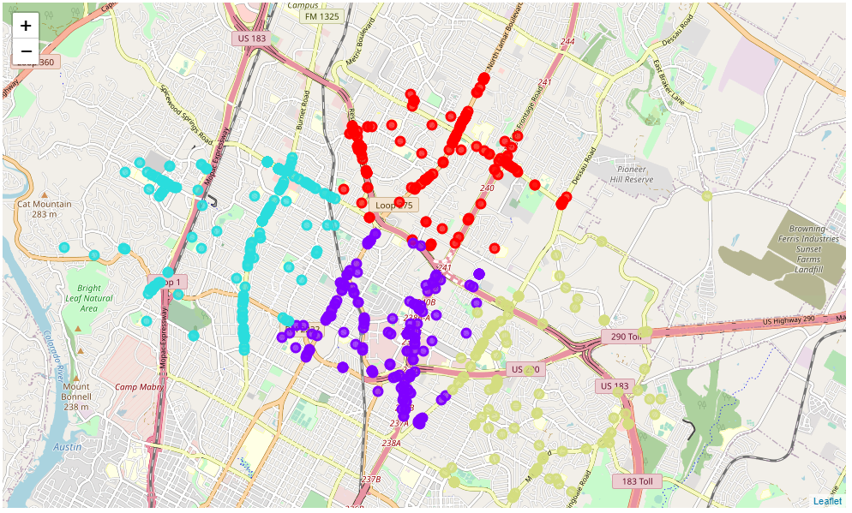
K-Means Clustering
Using the elbow method, the optimal k for k-means clustering for this data is k=4.
Cluster Color | Avg Distance from Nearest Chick-Fil-A (miles) | Restaurant Density
Red | 3.70 | 163
Purple | 3.80 | 151
Teal | 3.48 | 186
Olive Green | 4.38 | 122

Slide 7
Results and Discussion
There is a big pocket in the North-Northwest area of Austin that doesn't have a Chick-Fil-A within 3 miles of any restaurant in the area. This is a prime area to pay attention to and look for opportunities. The purple cluster contains a college campus all of them are next to major roads and highways.
The result of this does not imply that these are the most optimal locations in the entire city of Austin. The purpose was only to find locations that are far enough away from a current operating Chick-Fil-A, that denizens may find it too far to travel, especially in Austin traffic.
The final decision on the optimal location is to be made by my acquaintance. Additional factors, such as population density, major roads, major offices or campuses, real estate availability and economic factors (both social and real estate) within each cluster should be considered.

